Slide 1

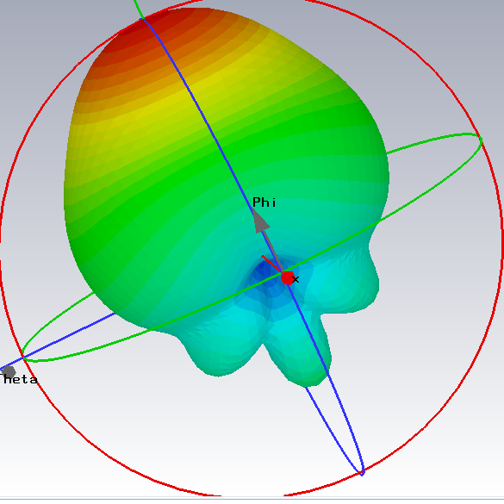
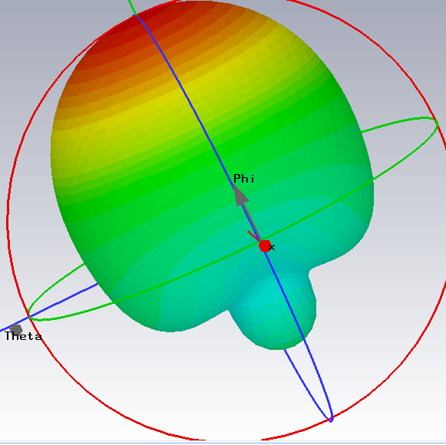
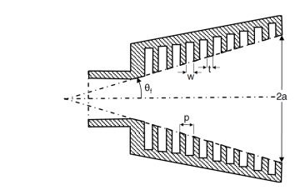
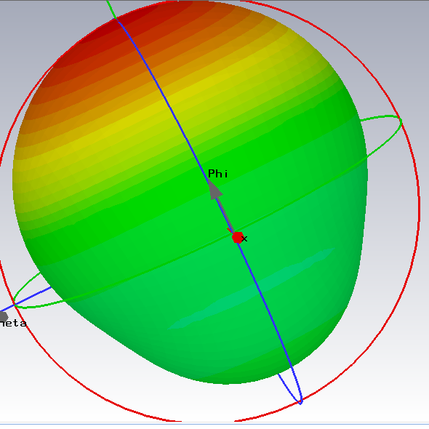
Corrugated horn antenna
A circular corrugated horn antenna.
There are three main reasons for corrugated horn antennas.
they exhibit radiation pattern symmetry.
they radiate with very low cross-polarization.
they offer a wide bandwidth responses.
Design frequency band is from 50MHz to 200MHz. The proposed conical corrugated horn design parameters as shown in Fig. 1, are θf=55°, w=20cm, t=20cm, p=33cm, height=1.1m, and 2a=2.4m, with depths changing from λ/2 to λ/4 smoothly. The λ is the wavelength at centre frequency.
1
3
4
5

Slide 2
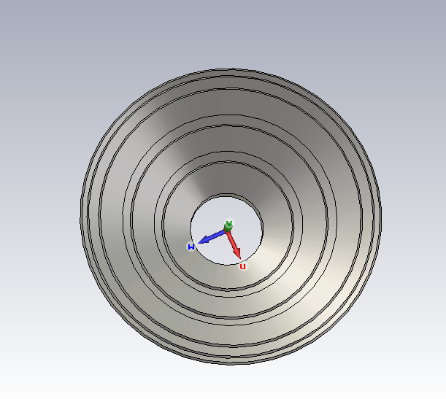
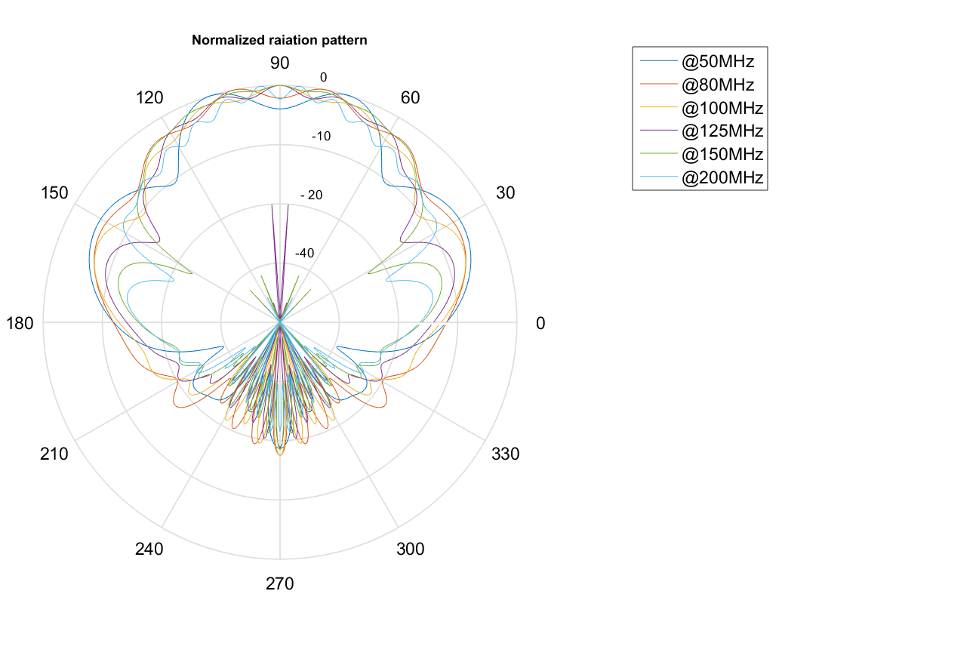
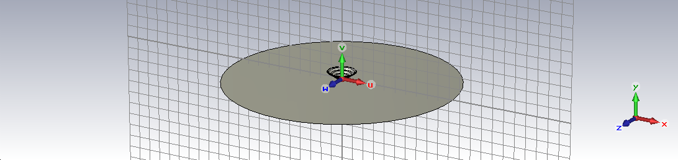
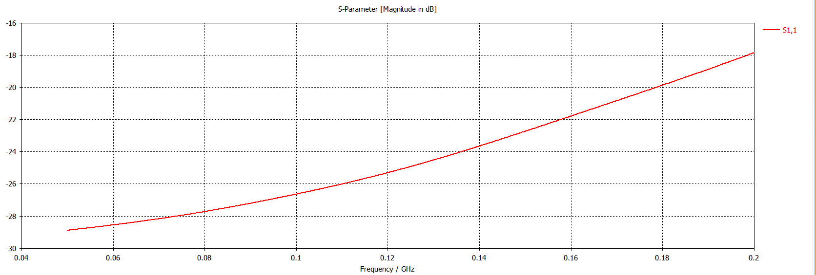
S11 parameters
10 m ground-plane

Slide 3
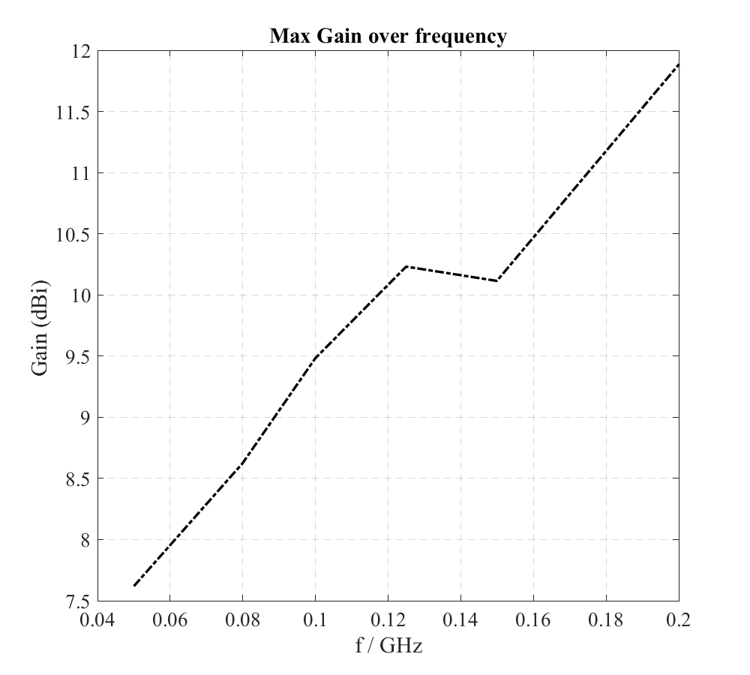
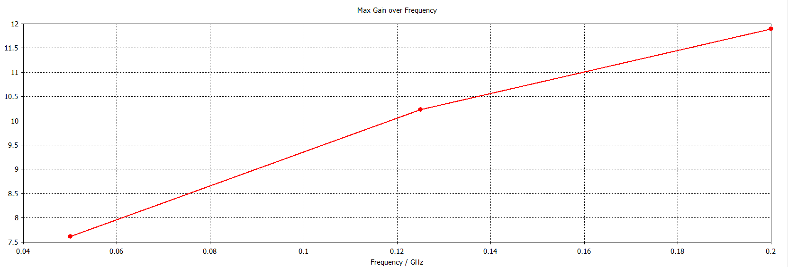
Ground-plane
Without ground-plane

Slide 4
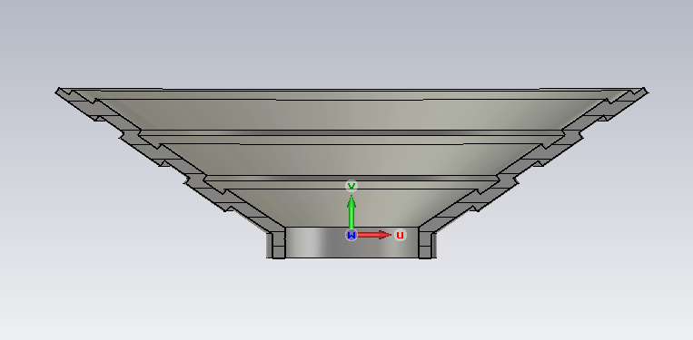
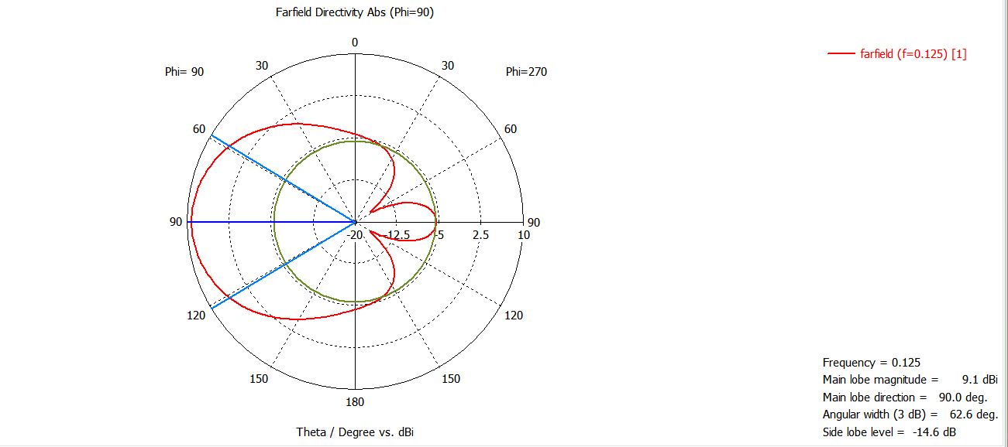
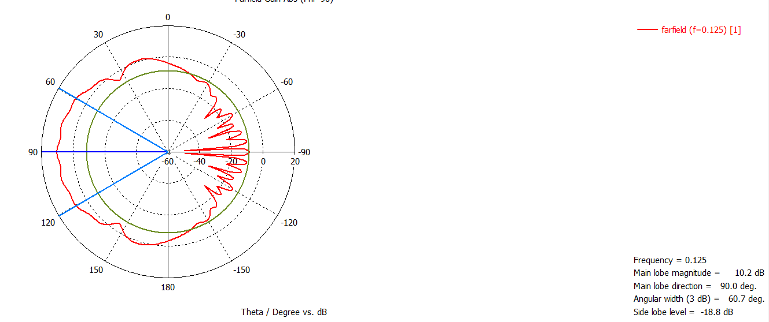
Radiation pattern @125Mhz
Ground-plane
Without ground-plane

Slide 5
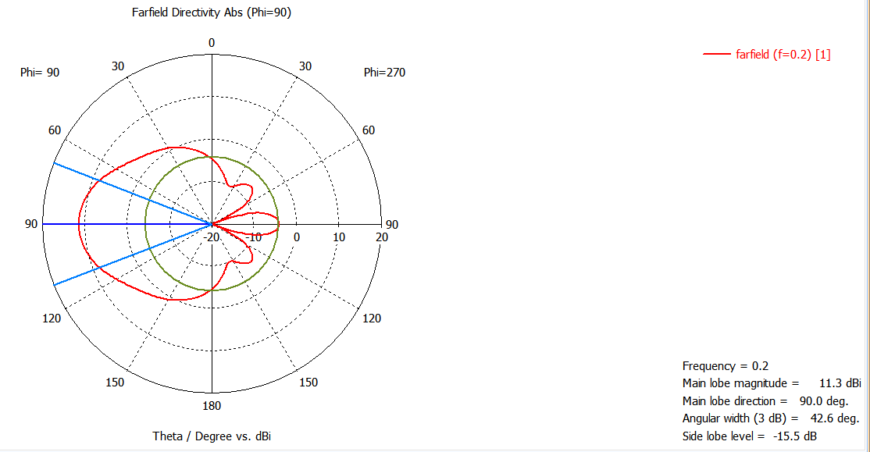
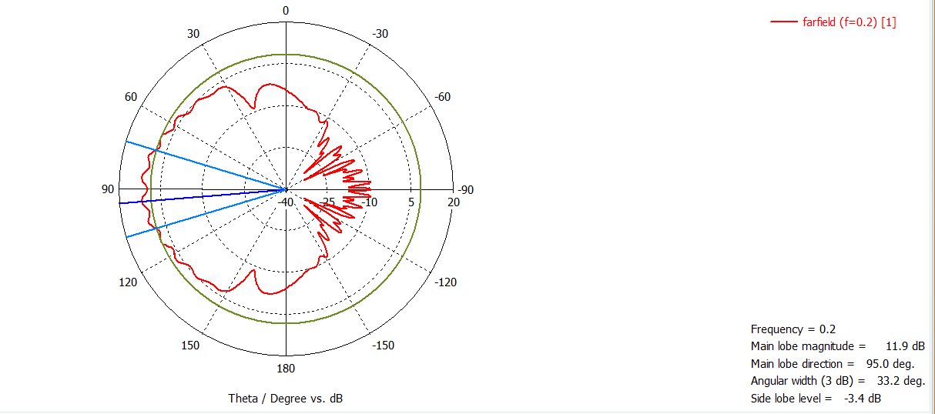
Radiation pattern @200Mhz
Ground-plane
Without ground-plane

Slide 6
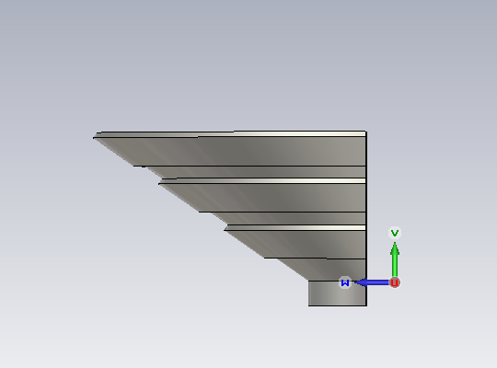
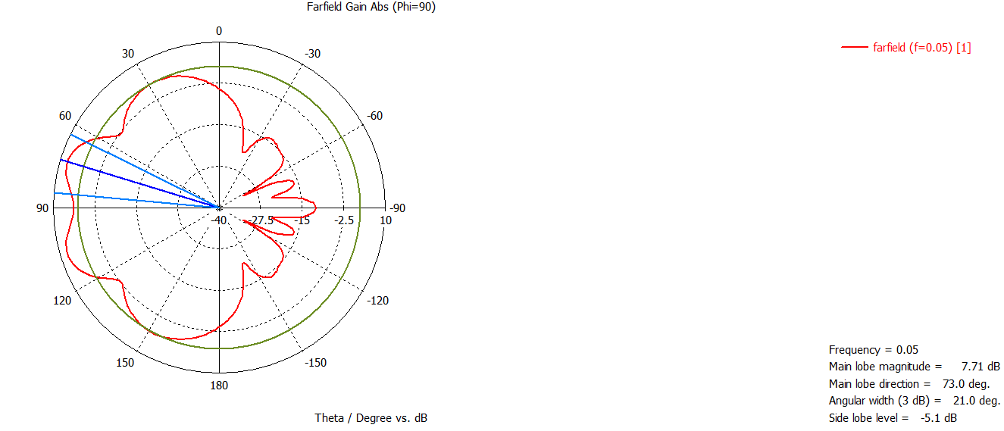
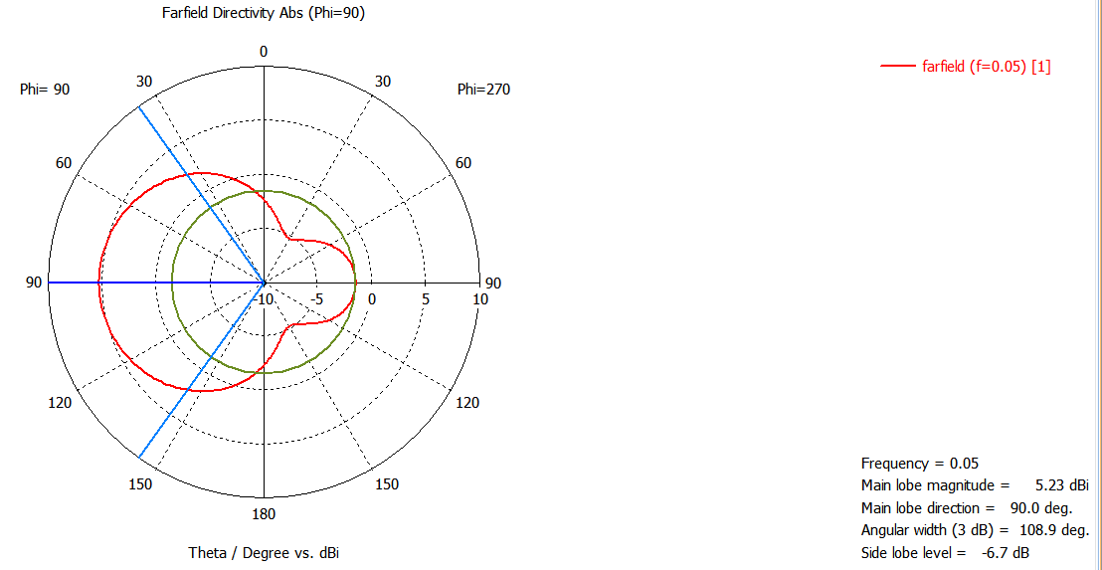
Radiation pattern @50Mhz
Without ground-plane
Ground-plane

Slide 7
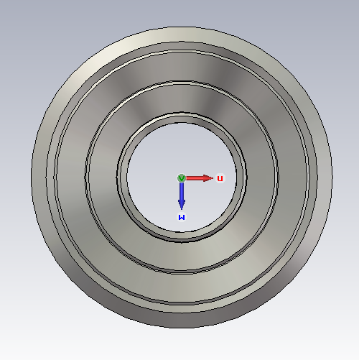
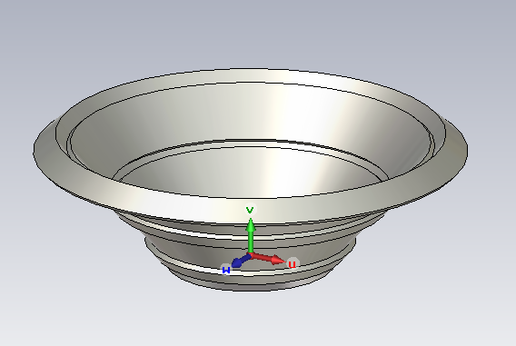
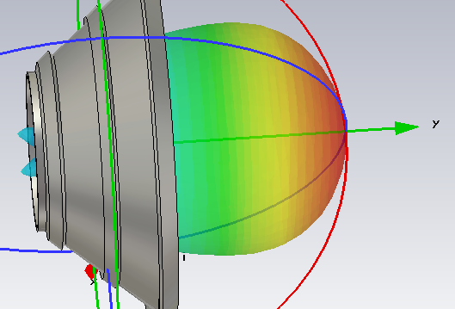
Corrugated horn antenna 2
A circular corrugated horn antenna.
There are three main reasons for corrugated horn antennas.
they exhibit radiation pattern symmetry.
they radiate with very low cross-polarization.
they offer a wide bandwidth responses.
Design frequency band is from 50MHz to 200MHz. The proposed conical corrugated horn design parameters as shown in Fig. 1, are θf=40, height=2.98m, and 2a=4.58m, with depths changing from λ/2 to λ/4 smoothly. The λ is the wavelength at centre frequency.
1
3
4
5

Slide 8
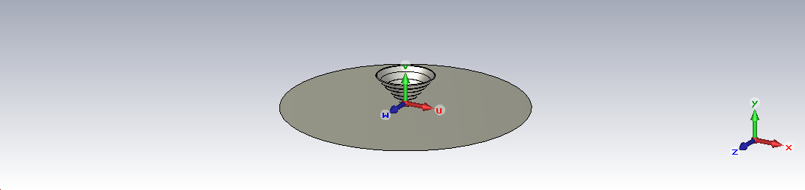
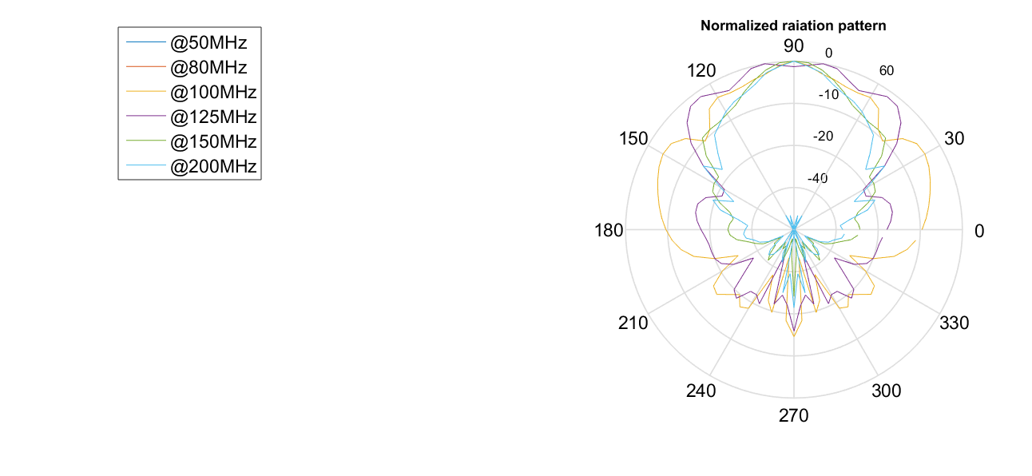
10 m ground-plane

Slide 9
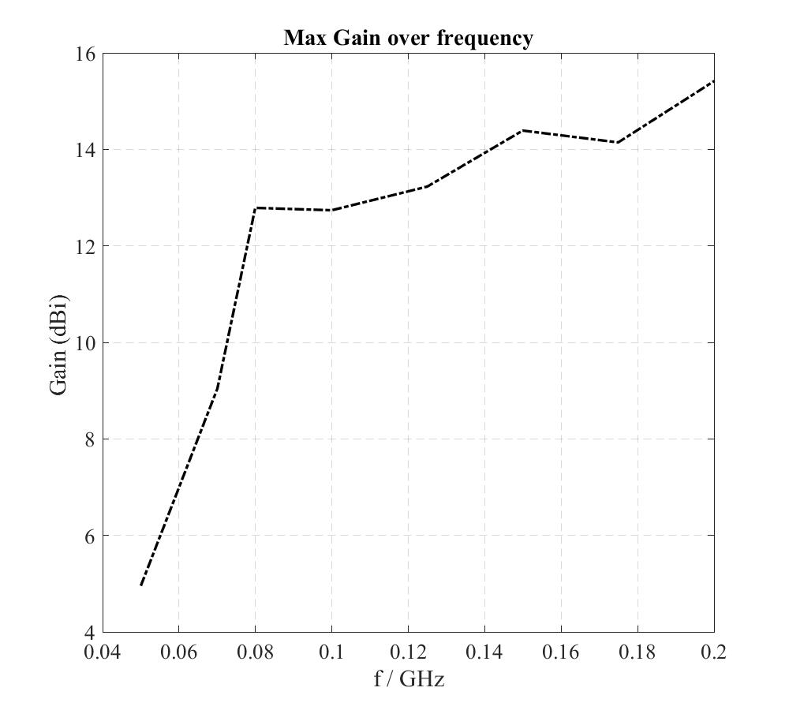
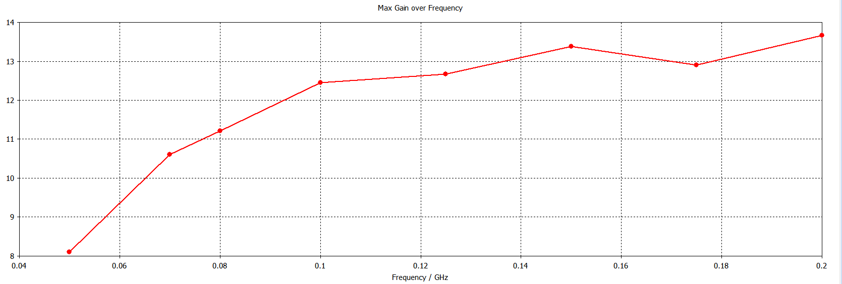
Without ground-plane
Ground-plane

